Slide 1

IBM SkillsBuild for Adult Learners - Data Analytics
Data Analytics Internship Program 2024 Final Project Presentation
Project Name :Early Warning Systems
Unique ID : IBM0100
Team Name : AnalytIQ
College Name : Ajay Kumar Garg Engineering College, Ghaziabad

Slide 2


Team Members
Atul Kumar
Janhavi Dubey
Shreya Chaudhary
Varsha Raj
Vasu Saini

Slide 3


Introduction
Overview of the Project
The "Early Warning Systems" project is designed to leverage data analytics for improving early warning systems for natural disasters such as earthquakes, hurricanes, and floods. This initiative aims to enhance the accuracy and timeliness of disaster predictions by integrating and analyzing diverse datasets. It supports Sustainable Development Goals (SDG) 13: Climate Action, and SDG 11: Sustainable Cities and Communities, by working towards increasing community resilience and minimizing the impacts of natural disasters.
Objective
The primary objective of the project is to develop and refine early warning systems for natural disasters using advanced data analytics. This involves:
Collecting and integrating diverse datasets from multiple sources related to natural disasters.
Utilizing sophisticated data analytics tools to improve prediction accuracy and response times.
Developing predictive models for various types of natural disasters.
Creating an efficient alert system that operates based on real-time data analysis.
Providing actionable insights and recommendations to stakeholders for improved disaster preparedness and response.
Contributing to the achievement of SDG 13 and SDG 11 by boosting community resilience and reducing the impact of natural disasters.

Slide 4


Problem Identification
Problem Statement
Natural disasters pose a significant threat to human life, infrastructure, and economic stability due to their unpredictability. Current early warning systems often face challenges such as limited data integration, insufficient accuracy, and delayed alerts, leading to inadequate preparation and response. This results in substantial damage and loss during such events. There is an urgent need for advanced data analytics to enhance the predictive capabilities of these systems, which would enable more timely and effective disaster responses and mitigation efforts.
Significance of the Problem
The significance of improving early warning systems through data analytics is multifaceted:
Human Safety: Enhanced predictive accuracy can lead to earlier warnings, giving people more time to evacuate or take necessary precautions, potentially saving thousands of lives.
Infrastructure Protection: Timely predictions can help protect critical infrastructure by allowing for the implementation of necessary safeguards and the preparation of emergency response strategies.
Economic Stability: By mitigating the impact of natural disasters, these systems can significantly reduce economic losses from damage to property and disruptions to business operations.
Relevant SDGs
SDG 11: Sustainable Cities and Communities
SDG 13: Climate Action

Slide 5

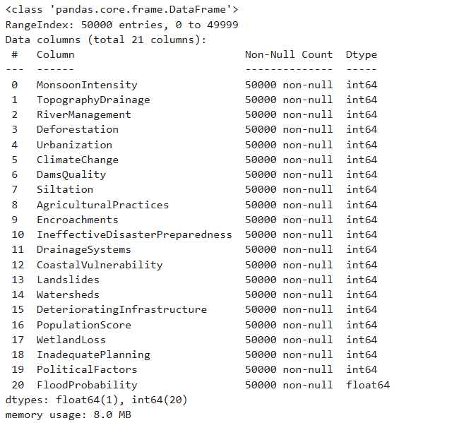

Data Collection
Sources of Data
Kaggle: Access to a wide array of datasets related to natural disasters, weather patterns, and seismic activity.

Slide 6
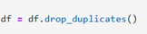
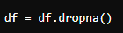
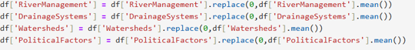
Data Preprocessing
Data Cleaning Method
Removing Duplicates:-
Handling Missing Values
Deletion:-
Using Indicators:-
Imputation:

Slide 7



Data Analysis
Analytical Tools and Methods Used
The project leverages a combination of tools and programming languages to handle different aspects of data analysis:
Python: The backbone for advanced data analysis, modeling, and visualization. Python's extensive libraries such as Pandas for data manipulation, NumPy for numerical data, Matplotlib and Seaborn for data visualization, and Scikit-learn for machine learning make it ideal for this project.
Dashboard Tools: Power BI is used for creating interactive dashboards that present findings, visualize trends, and alert decision-makers in real-time.
Key Findings
The analysis and modeling in the "Early Warning Systems" project yielded key findings:
Predictive models displayed high accuracy in forecasting natural disasters, pinpointing crucial influencing variables.
Significant data gaps were identified, especially in under-monitored areas and for rarer disaster types, suggesting a need for increased data collection.
The project showcased improved response times, with faster alerts reducing lead times for warnings, thus enhancing the overall effectiveness of disaster responses.
Insights Derived
Insights from the "Early Warning Systems" project enhance disaster strategies: Improved risk assessments using predictive models, better resource allocation, supported policy changes for infrastructure safety, increased community engagement, and potential technological advancements like AI for real-time data analysis, boosting disaster preparedness and response.

Slide 8
Hypothesis Development
Formulated Hypothesis:
Advanced data analytics will significantly enhance the accuracy and timeliness of early warning systems for natural disasters, thereby improving community preparedness and reducing impact.
Rationale Behind the Hypothesis:
Natural disasters can cause severe damage due to unpredictable timing and inadequate warnings. Current early warning systems often struggle with data integration, accuracy, and timely alerts.
By leveraging advanced data analytics, which integrates diverse datasets and utilizes sophisticated models, it is hypothesized that these systems can predict disasters more accurately and issue alerts more promptly.
Method for Testing the Hypothesis:
Data Collection and Integration:
Collect data from sources like Kaggle, government agencies, and historical records.
Integrate and preprocess the data for analysis.
Predictive Modeling:
Develop and train machine learning models to forecast disasters.
Validate models using historical and real-time data.
Visualization and Reporting:
Create dashboards for clear data presentation.
Report on findings, methodologies, and recommendations.

Slide 9
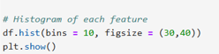
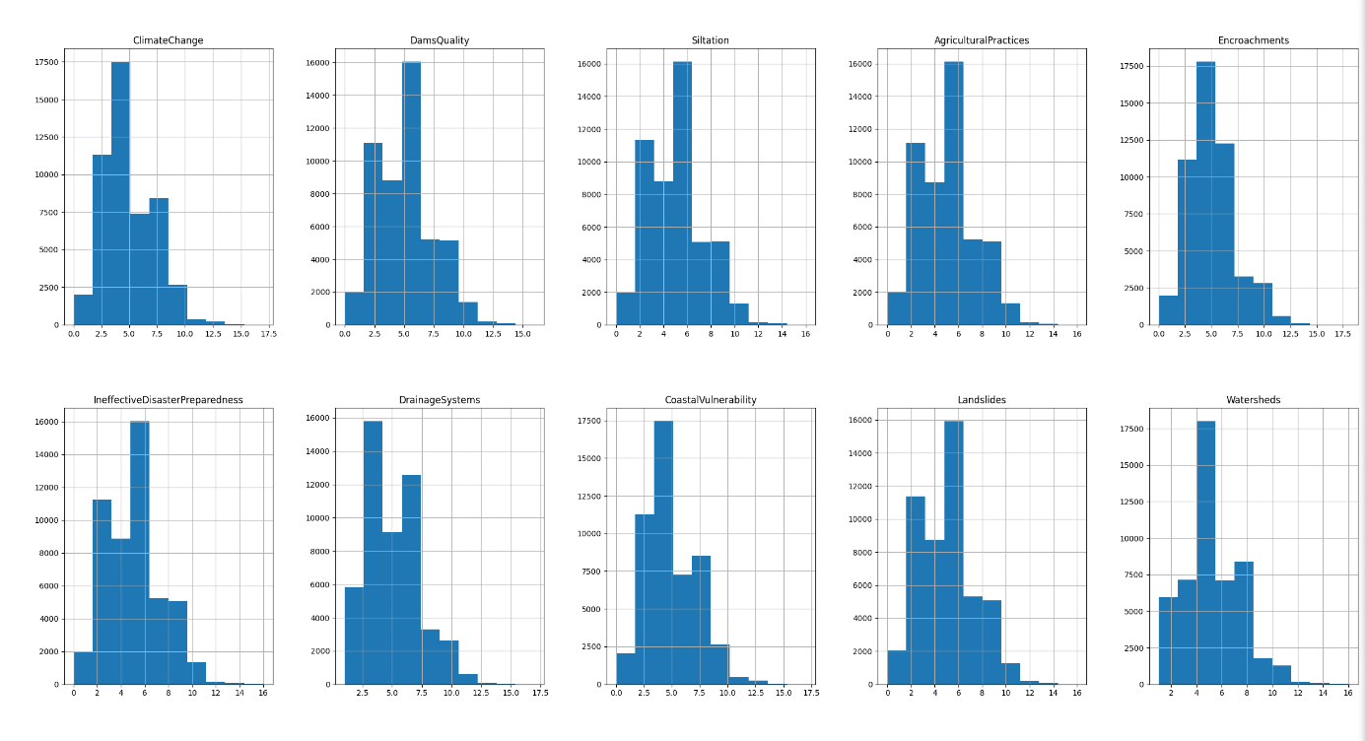
Visualization
Histogram of the features included in the Dataset
Libraries: Use Matplotlib, Seaborn, and Plotly for creating plots and interactive charts.
Types: Generate various plots like line graphs, bar charts, and heatmaps.
Purpose: Helps in understanding data patterns and insights visually.

Slide 10
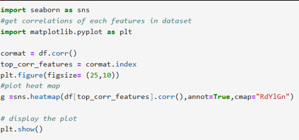
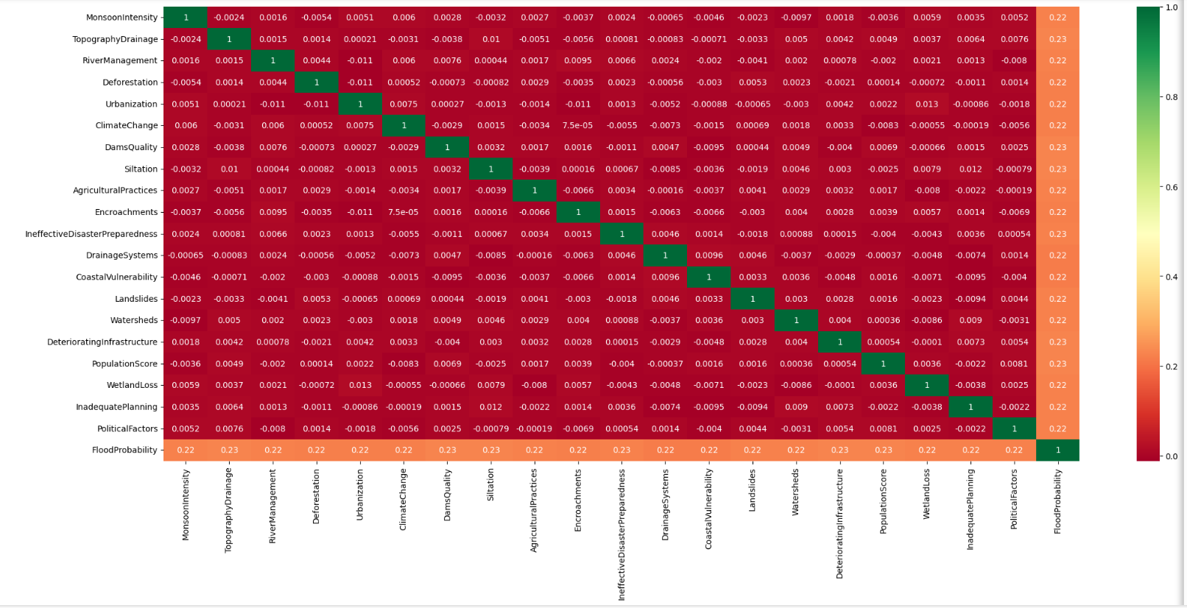
Fig: Heatmap Correlation
of each feature in the dataset

Slide 11
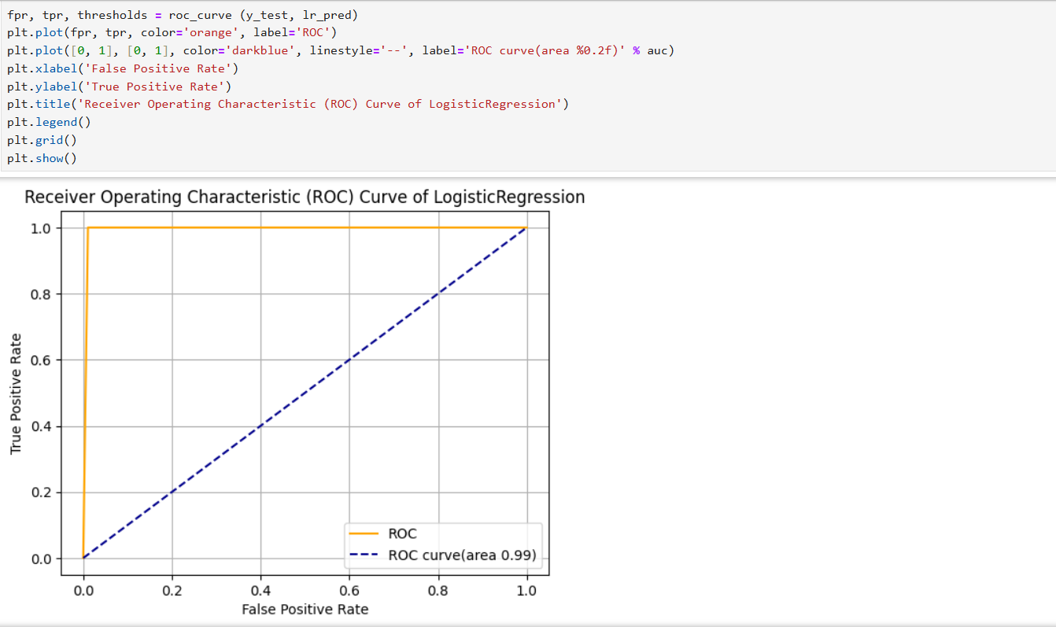
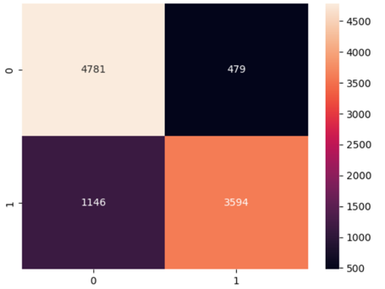
LEARNING ALGORITHMS – LOGISTIC REGRESSION
Confusion matrix of Logistic 14
Regression
Roc-AUC score chart comparison of Logistic Regression

Slide 12
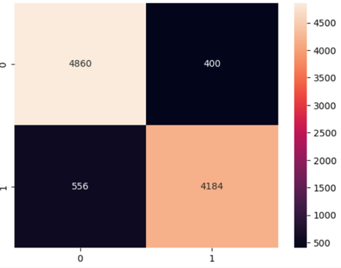
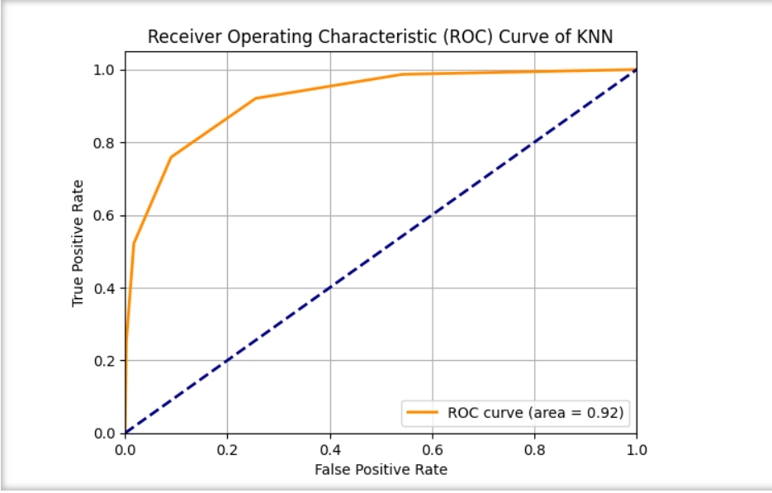
KNN ALGORITHM
Confusion matrix of KNN
Roc-AUC score chart comparison of KNN

Slide 13
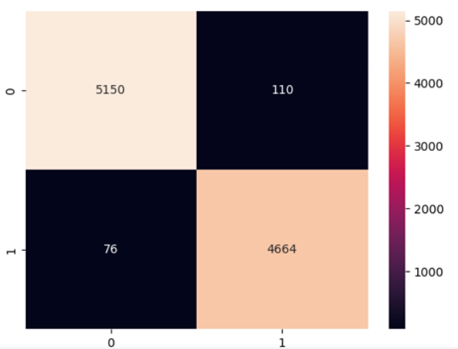
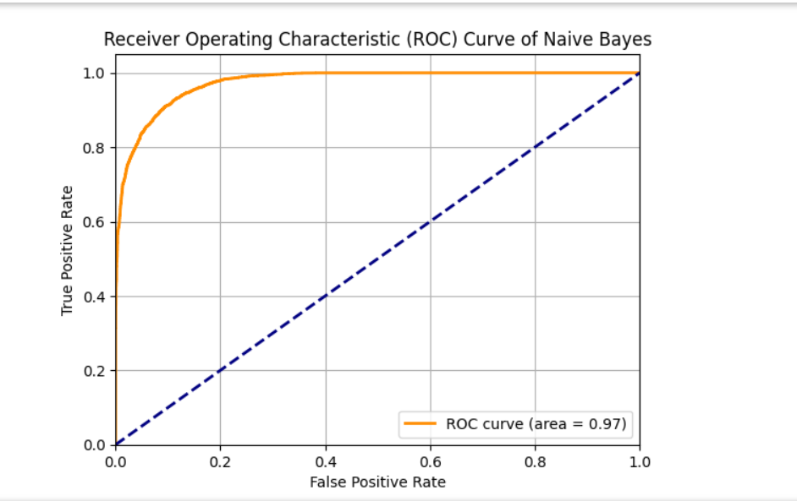
NAIVE BAYES
Confusion matrix of Naïve Bayes
Roc-AUC score chart comparison of Naïve Bayes

Slide 14
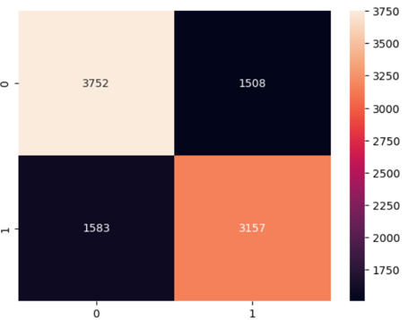
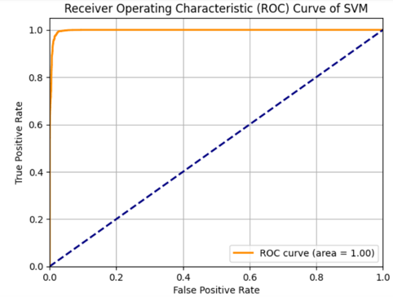
SUPPORT VECTOR MACHINE
Confusion matrix of SVM
Roc-AUC score chart comparison of SVM

Slide 15
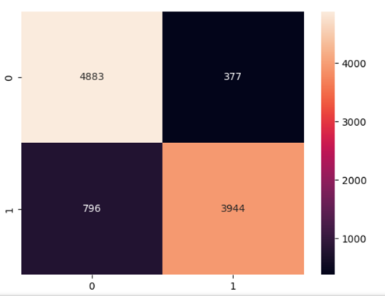
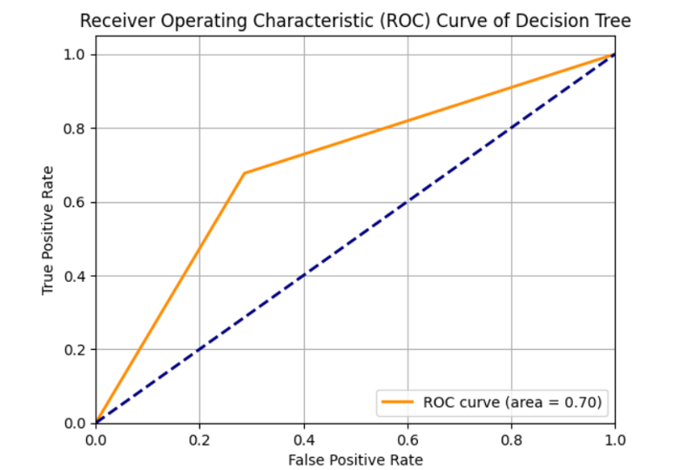
DECISION TREE
Confusion matrix of Decision Tree
Roc-AUC score chart comparison of Decision Tree

Slide 16

Conclusion
Summary of Findings: The project revealed that integrating diverse datasets and advanced analytics significantly improves early warning systems for natural disasters. Enhanced predictive models and real-time data analysis can lead to more accurate and timely alerts.
Impact of Proposed Solution: The solution is expected to boost predictive accuracy, enable efficient real-time alerts, and provide actionable insights, leading to better disaster preparedness and community resilience. This will align with SDG 13 and SDG 11 by reducing disaster impact and supporting sustainable communities.
Future Work: Future efforts should focus on refining models based on real-world data, expanding stakeholder training, and continuously improving the system’s accuracy and efficiency through iterative testing and feedback.

Slide 17
References
Data Sources – Kaggle datasets and data from various websites.
Tools and Software Used – Kaggle, VSCode, Python, Jupyter Notebook.
Additional References – Open Source Data on GOVT. websites.

